Slide 1

Advanced Algorithm Design
what you need to know

Slide 2

Algorithmic Design Patterns
You need to be familiar with the following algorithmic design patterns:
Divide and Conquer
Decrease and Conquer
Dynamic Programming
Backtracking (and tree searches)
Randomised Heuristics

Slide 3
Divide or Decrease
Divide and conquer algorithms repeatedly split the size of the input and perform an operation on each of the divided parts of the input.
Eg: Mergesort, Quicksort,
This is different to Decrease and Conquer which will reduce the size of the input and then perform an operation on just one part of the reduced input.
Eg: Binary Search

Slide 4
Dynamic Programming
Dynamic Programming is an algorithmic approach that involves trading increased space complexity for reduced time complexity.
Typically, this is done by storing the values of repeated calculations so that they no longer have to be repeated every time they are needed and can instead just be recalled.

Slide 5

Change Making & Dynamic Programming
You have been commissioned by the country Dollaropia to create an algorithm that can tell a machine what coins it should give a person in order to make up their change.
Because Dollaropia is a bit stingy, they always want the machine to give the minimum number of coins possible as change.
The coins that are available in Dollaropia are
the $4, $3 and $1 coins.

Slide 6
Change Making & Dynamic Programming
A simple solution could be as follows:
ChangeAlgo(c)
//Input: An integer c that represents the amount of change to be given back
//Output: A list of the coins to paid out
Coins = Coins[ ]
While c > 0
Temp = 0
for each different type of coin that you have, d
if d < c and d > Temp
Temp := d
c := c - Temp
append Temp to list Coins[ ]
return Coins[ ]

Slide 7
Change Making & Dynamic Programming
A simple solution could be as follows:
ChangeAlgo(c)
//Input: An integer c that represents the amount of change to be given back
//Output: A list of the coins to paid out
Coins = Coins[ ]
While c > 0
Temp = 0
for each different type of coin that you have, d
if d < c and d > Temp
Temp := d
c := c - Temp
append Temp to list Coins[ ]
return Coins[ ]
But does this actually work? what would this give if it was told to give $6 worth of change

Slide 8
Change Making & Dynamic Programming
So what about brute forcing an approach?
BruteChangeAlgo(c)
//Input: An integer c that represents the amount of change to be given back
//Output: the minimum number of coins required to be able to make that change
If c = 0,
return 0
Else
min = ∞+
for each different type of coin that you have, d
if (BruteChangeAlgo(c - d) + 1 < min)
min = BruteChangeAlgo(c - d) + 1
return min

Slide 9
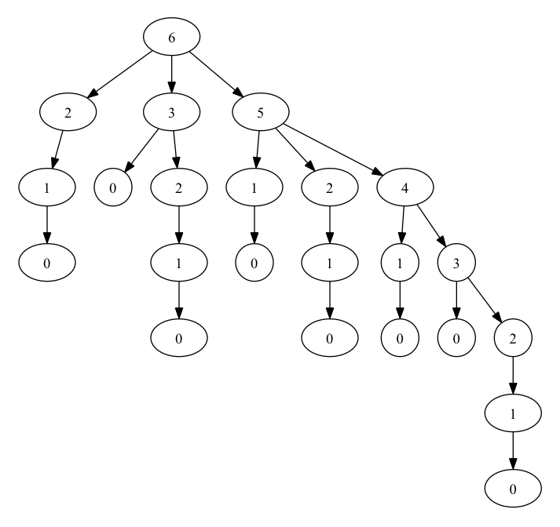
Change Making & Dynamic Programming
Let’s visualise how the brute force approach works...

Slide 10
Change Making & Dynamic Programming
Let’s visualise how the brute force approach works...
You can see that this is repeatedly calculating the same things over and over again. If it stored the answer for say $2, it could just recall the change needed without recalculating saving time. This is what Dynmaic Programming does!

Slide 11

Problem 1 - Catalan Numbers
What is the n^{th} Catalan number?
The n^{th} Catalan number can be calculated using the following rule:

Slide 12
Problem 1 - Catalan Numbers
ALGORITHM Cat(n)
//Input: An integer n
//Output: The value of the n^{th} Catalan Number
C = C[ ]
C[ 0 ] = 1
For i = 1 to i = n
C[ i ] = 0
for j = 0 to j = i - 1
C[ i ] = C[ i ] + C[ j ] x C[ i - j -1 ]
return C[ n ]

Slide 13
Problem 2 - Coin Row
There is a row of n coins whose values are some positive integers c1, c2, . . . , cn, not necessarily distinct. The goal is to pick up the maximum amount of money subject to the constraint that no two coins adjacent in the initial row can be picked up.

Slide 14
Problem 2 - Coin Row
ALGORITHM CoinRow(C[ 1…n ])
//Input: A list representing the values of the available coins in their order of arrangement
//Output: The maximum value of coins that can be picked up from this list (without selecting two coins that are
adjacent)
F[ 0 ] ← 0
F[ 1 ] ← C[ 1 ]
For i = 2 to i = n
F[ i ] = maximum value of (C[ i ] + F[i -2 ], F[i - 1 ])
return F[ n ]

Slide 15
Problem 3 - Coin Collection
Several coins are placed in cells of an n × m board, no more than one coin per cell. A robot, located in the upper left cell of the board, needs to collect as many of the coins as possible and bring them to the bottom right cell. On each step, the robot can move either one cell to the right or one cell down from its current location. When the robot visits a cell with a coin, it always picks up that coin. Design an algorithm to find the maximum number of coins the robot can collect and a path it needs to follow to do this.

Slide 16
Problem 3 - Coin Collection
ALGORITHM CoinColl(C[ 1…n , 1…m])
//Input: A n x m array of either 1’s and 0’s where 1 represents a coin at that location and 0 represents no coins.
//Output: The maximum value of coins that can be picked up following the rules of moving only down or to the right.
F[ 1 , 1 ] ← C[ 1 , 1 ]
for j = 2 to j = m
F[ 1 , j ] ← F[ 1 , j - 1 ] + C[ 1 , j ]
For i = 2 to i = n
F[ i , 1 ] = F[ i - 1, 1 ] + C[ i , 1 ]
for j = 2 to j = m
F[ i , j ] = Maximum value of ( F[ i - 1, j ] or F[ i , j - 1] ) + C[ i , j ]
return F[ n , m ]

Slide 17
Problem 3 - Coin Collection
ALGORITHM CoinColl(C[ 1…n , 1…m])
//Input: A n x m array of either 1’s and 0’s where 1 represents a coin at that location and 0 represents no coins.
//Output: The maximum value of coins that can be picked up following the rules of moving only down or to the right.
F[ 1 , 1 ] ← C[ 1 , 1 ]
for j = 2 to j = m
F[ 1 , j ] ← F[ 1 , j - 1 ] + C[ 1 , j ]
For i = 2 to i = n
F[ i , 1 ] = F[ i - 1, 1 ] + C[ i , 1 ]
for j = 2 to j = m
F[ i , j ] = Maximum value of ( F[ i - 1, j ] or F[ i , j - 1] ) + C[ i , j ]
return F[ n , m ]
∙ | ∙ | ∙ | ∙ | $ | ∙
∙ | $ | ∙ | $ | ∙ | ∙
∙ | ∙ | ∙ | $ | ∙ | $
∙ | ∙ | $ | ∙ | ∙ | $
$ | ∙ | ∙ | ∙ | $ | ∙

Slide 18
Tree Search with Backtracking
This approach involves the algorithm generating possible candidates as solutions to a problem. As it generates the candidate, if it comes to a point where it can recognise that the partially complete candidate will not result in a valid solution, it backtracks to an earlier version of the candidate where it then makes a different choice.
It is essentially similar to a brute force approach but with the improvement that it is able to abandon a candidate when it recognises that it won’t give a good solution.
Eg: Solving a Sudoku is often done using backtracking or finding a path through a maze.
Backtracking is an important component of Depth First Search

Slide 19

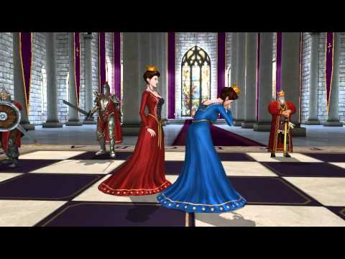
The Queen’s Problem

Slide 20
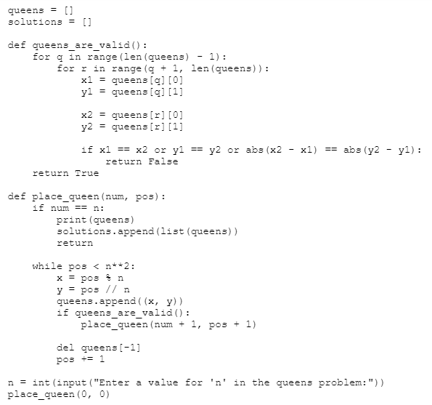
Continue the depth-first tree search if valid

Slide 21
Backtrack if not valid
- Child branches are not considered (pruned)

Slide 22
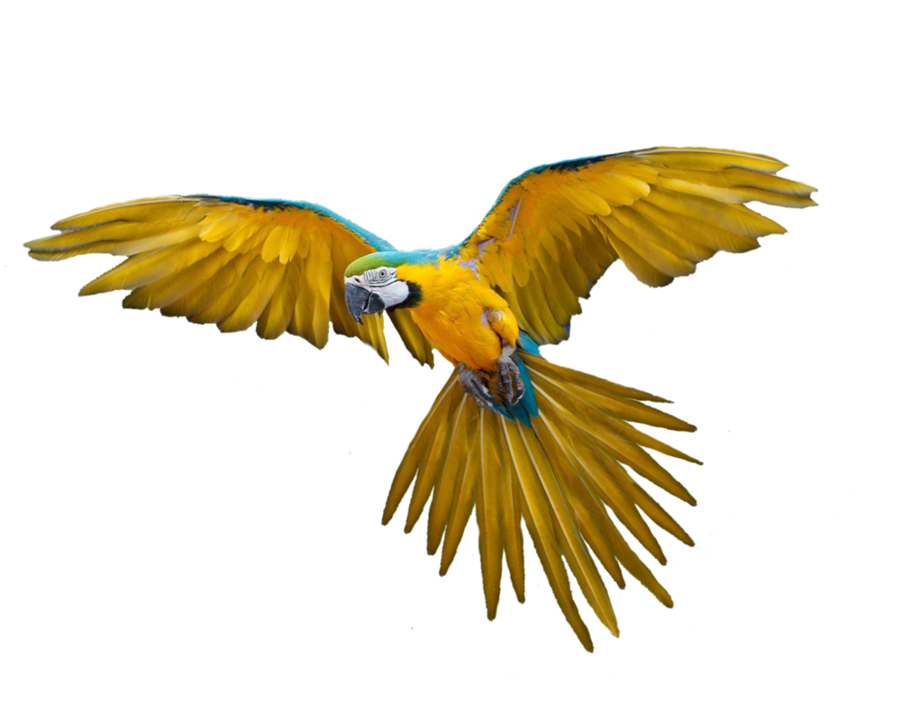
Randomized Heuristics
The use of randomized heuristics is an attempt to find a ‘good enough’ solution to a problem that would otherwise be intractable.
They are generally composed of a random component that might generate a starting point that can then be improved upon or make random changes to a certain solution to attempt to improve it.
Simulated Annealing is an example of a radomised heuristic. So is, when you reach a fork in the road, flip a coin and go in the direction closest to the direction in which the last bird you saw was flying in.

Slide 23
Randomized Heuristics
Randomized Heuristics will rarely give you the optimal solution (and in fact you can never know if it has or not due to the nature of the problems being unverifiable in polynomial time).
They can give sub-optimal solutions though which can be considered ‘good enough’ for the problem they are solving.

Slide 24

Specific Algorithms
You need to be familiar with the following algorithms:
Mergesort
Quicksort
Mini-Max
Simulated Annealing

Slide 25
Specific Problems
You also need to know about the following problem types and have some ideas of ways in which they can be solved:
Graph Colouring
Travelling Salesman
Knapsack Problem

Slide 26
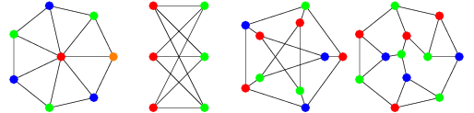
Graph Colouring
Is there a way to colour a graph with no two adjacent nodes being the same colour?
Decision Problem
Can the graph be coloured in n colours?
Optimisation Problem
What is the minimum number of colours needed to colour the graph?

Slide 27
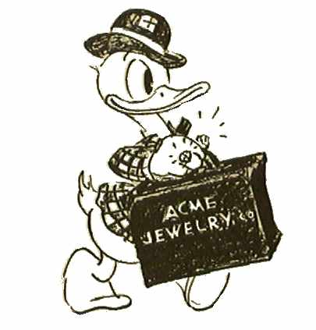
Travelling Salesman
How should a salesman travel through all of the cities on a map in the minimum time/distance?
Decision Problem
Can the graph be traversed in less than x minutes/kms?
Optimisation Problem
What is the shortest route to visit all of the cities in the graph?

Slide 28
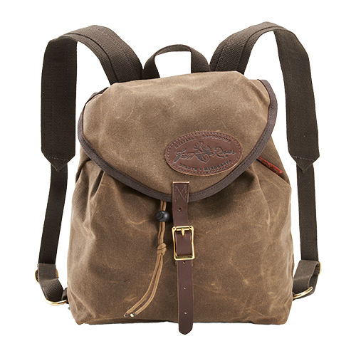
The Knapsack Problem
Given a set of items, each with weight and value, determine the number of each item that can be included in a knapsack of given contraints?
Decision Problem
Can the knapsack be filled with items of value greater than x?
Optimisation Problem
What is optimal number of each item to pack in the knapsack to maximise the total value?

